Slide 1
Genome Informatics at Iowa State University
Transforming raw data into informative data for researchers
Andrew Severin
Genome Informatics Facility
Iowa State University
206 Science I
Iowa State University

Slide 2
What do I do?
Enable researchers to interpret high-throughput data
Encourage/Contribute to bioinformatics friendly infrastructure
Explore the latest open source software
Develop pipelines for efficient analysis
Contribute to papers and grants (LOS)
Train and Teach Bioinformatics
Write Grants
Meet the needs and communicate well with a diverse faculty to help facilitate NGS research on campus.
http://gif.biotech.iastate.edu
GIF@iastate.edu

Slide 3
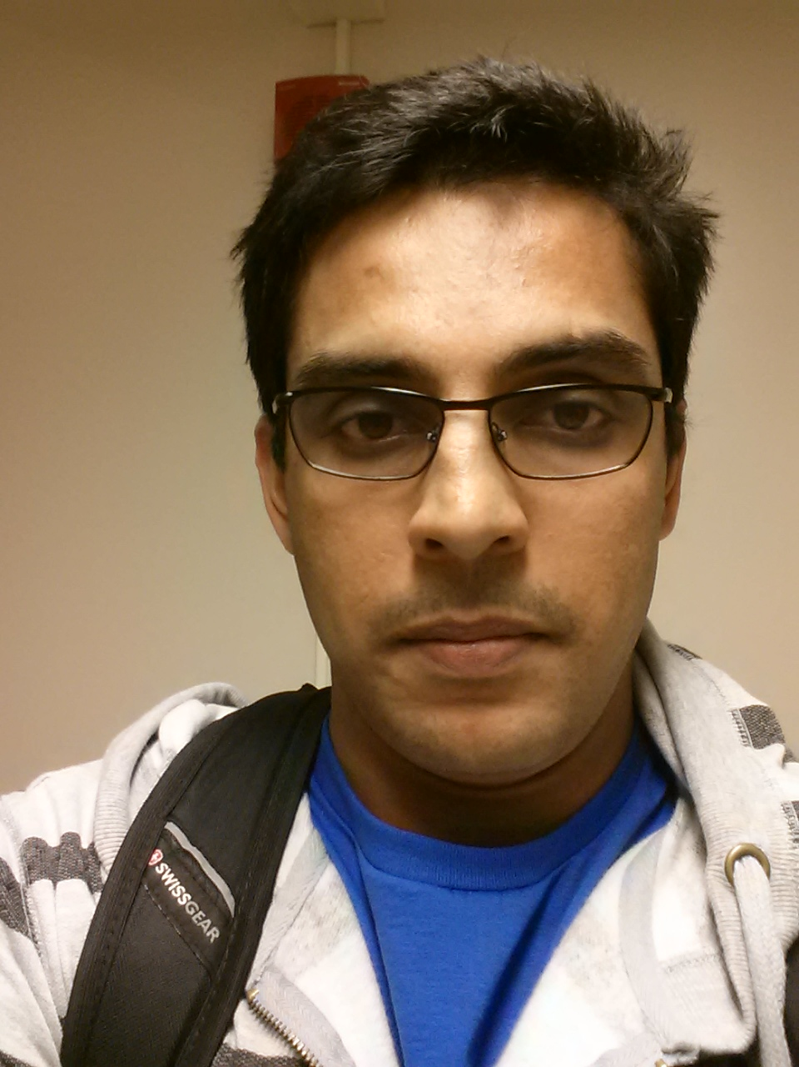
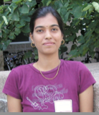
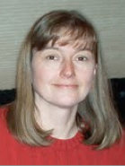
GIF Team
Arun Seetharam
Usha Muppirala
Margie Carter
Notes:
On the point ..
Main issue is I need more staff
Assistant Scientist IV is a new category that could help with hiring options but reduces retention incentives.

Slide 4
Workshop: Basic UNIX for Biologists

Slide 5
Have you ever….
tried to open a very large file (like FASTQ) in PC/Mac?
searching for a specific piece of information from large number of files?
wanted to rename large number of files?
combine large number of files into one big file?
got frustrated with excel auto-correcting your favorite gene?
wanted to run a program that isn’t available on your operating system?
bored of doing same things over and over?
You Need UNIX

Slide 6
What is UNIX?
Widely used multiuser operating system
Linux: free version of UNIX-like operating system
Red Hat Enterprise Linux, Ubuntu, and CentOS
Used on high-end workstations, database servers, web servers and managing shared resources
Standard features include:
Security, reliability, scalability
supports multi-user (as in 100s)

Slide 7
Can I learn UNIX?
Yes! Absolutely. Anyone can if they want.
No more difficult than learning Word, Excel or Powerpoint
Biggest difference
In Unix: You type the command to execute
In Word: You use your mouse to execute a command
Remember. In the Terminal, “don’t touch the mouse”

Slide 8

Kernel and Shells
SHELL
USER 1
KERNEL
USER N
HARDWARE
SHELL types:
Bourne Shell (sh)
C shell (csh)
TC shell (tcsh)
Korn shell (ksh)
Bourne Again Shell (bash)
Z shell (zsh)
Notes:
I am telling you this for your information. These are the advantages you get by using Unix. All of this is done transparently.

Slide 9
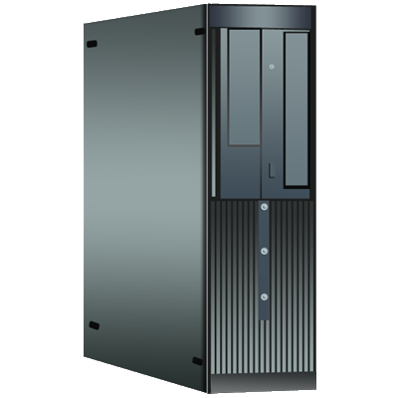
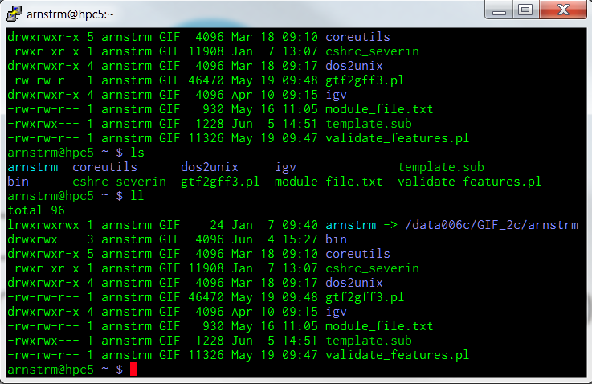

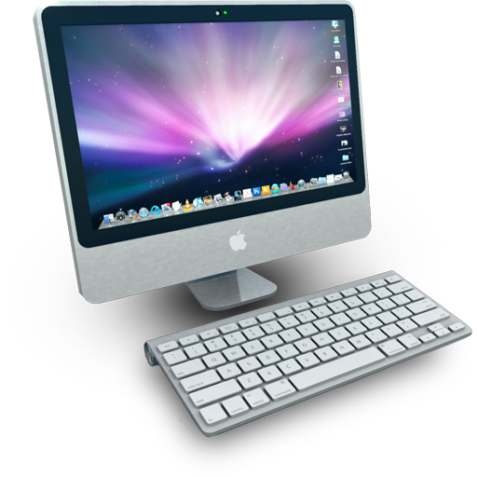
High Performance Computing (HPC)
HPC-class (education)
48 compute nodes
16 processors/node (768 total)
64Gb RAM/node (3.0Tb total)
Lightning3 (research)
17 compute nodes
32 processors/node (384 total)
256Gb RAM/node (3.2Tb total)
Compute Nodes
Condo (up coming)
316 compute nodes
8 processors/node (2528 total)
8Gb RAM/node (3.5Tb total)
Head Node
Terminal
SSH
Notes:
Can throw almost anything at it.
Lightning3 is a shared resource that researchers have been buying into it.
Condo will be an order of magnitude more nodes.

Slide 10
Using Linux
Linux, Mac OS X, Solaris, Cygwin
Many variants, same commands
I will refer to them all as Linux
All Macs have Linux under the hood (Darwin)
Finder search for X11 or terminal
Windows requires an emulator (Putty)
GIF@iastate.edu
http://gif.biotech.iastate.edu

Slide 11
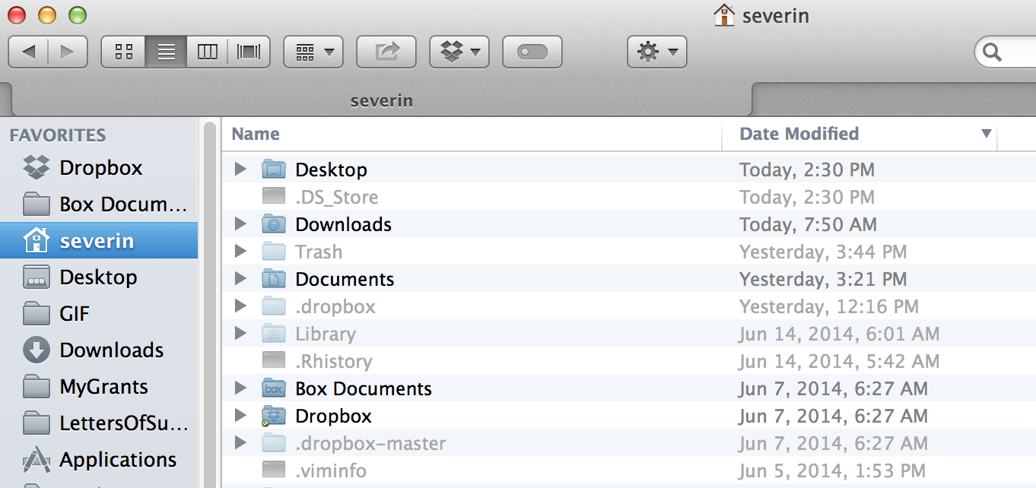

GIF@iastate.edu
http://gif.biotech.iastate.edu

Slide 12
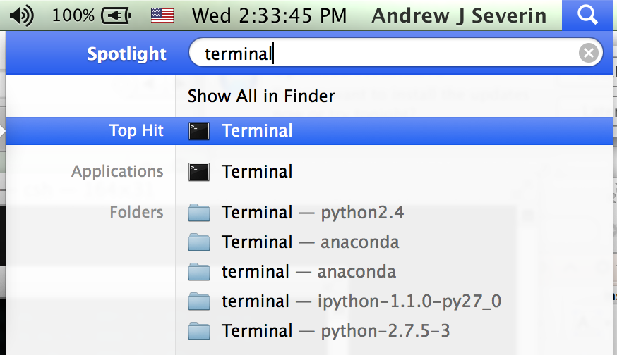
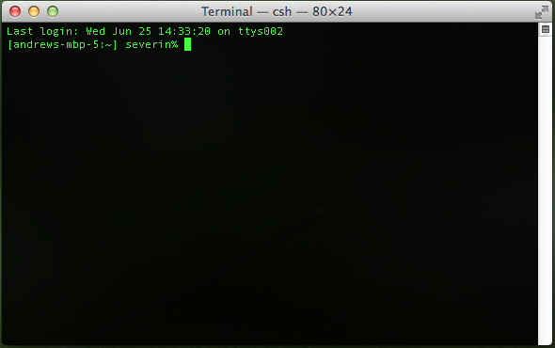
GIF@iastate.edu
http://gif.biotech.iastate.edu

Slide 13
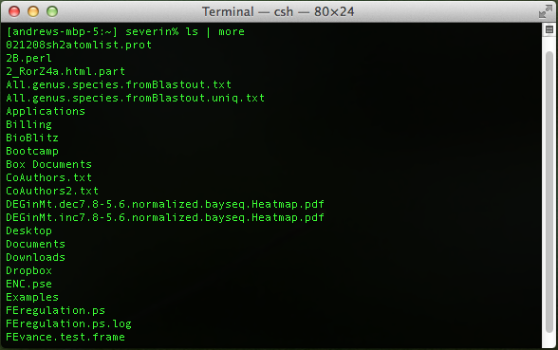
GIF@iastate.edu
http://gif.biotech.iastate.edu

Slide 14
Running list of commands
Pull out a sheet of paper and as we learn new commands right them down as we go to refer back to.

Slide 15
Commands in Part I
Navigation cd, ls, pwd
File creation touch,nano,mkdir,cp,mv,rm,rmdir
Reading more,less,head,tail,cat
Compression zip,gzip,bzip2,tar,compress
Uncompression unzip,gunzip,bunzip2,uncompress
Permissions chmod
Help man

Slide 16
Terminal Window or Prompt
The > is where commands can be entered
The command line in the prompt.
Very Basic Linux Commands
cd = change directory
ls = list
pwd = path of working directory
GIF@iastate.edu
http://gif.biotech.iastate.edu

Slide 17
Downloading Class Materials
Hand-outs/files are available for download at https://github.com/ISUgenomics/Basic_UNIX
cd 
git clone https://github.com/ISUgenomics/Basic_UNIX
Once your cursor (command prompt) comes back to the original position, type
ls 
cd Basic_UNIX
ls 

Slide 18
Navigation
Where am I?
pwd
What is in my folder?
ls
Moving between folders
cd WORKSHOP_FILES/
ls
pwd
Moving back directories
cd ..
pwd
cd ..
pwd

Slide 19
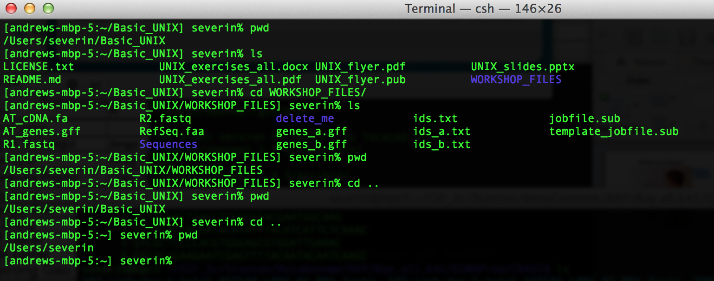
Output of Navigation

Slide 20
Go back into the directory
pwd
cd Basic_UNIX/
pwd
cd WORKSHOP_FILES/
pwd
ls
cd
pwd
The last command puts you back to /home/netid

Slide 21
Organization
Root Directory, whole tree starts from here
Contains fundamental executables (i.e., binaries) generally used by all users on the system
All users home directories are located here
/
..
etc
dev
home
Parent
Directory
usr
bin
.
My Home!
arnstrm
user2
user3
lib
Present
Directory
folder1
folder2
Relative path for fileA:
./folder2/fileA
Absolute path for fileA:
/home/arnstrm/folder2/fileA
fileA
Notes:
Stress again that this is just background that is important but will see often and get practice with in the exercises.

Slide 22
Repeat
pwd
cd Basic_UNIX/
pwd
cd WORKSHOP_FILES/
pwd
ls
/Users/netid/Basic_UNIX/WORKSHOP_FILES

Slide 23
Making and Moving
mkdir playarea
ls
cd playarea
touch myfile
mkdir mydirectory
mv myfile mydirectory
ls
ls mydirectory

Slide 24
Now, you try!
touch a b c d e
touch 1 2 3 4 5
Your goal is to mkdir two directories: numbers and letters, respectively. Then, mv these new files a-e and 1-5 into them.

Slide 25
Renaming files – The other kind of mv
touch Zylophone
mv Zylophone Xylophone

Slide 26
Editing files
Everyone make sure you are in this folder
/Users/netid/Basic_UNIX/WORKSHOP_FILES/playarea
touch fav.txt
nano fav.txt
Write your 3 favorite things in nano then press control and hit x, hit y, hit enter to exit out of nano.

Slide 27
Reading files
more fav.txt
less fav.txt (q to quit)
cat fav.txt
head fav.txt
tail fav.txt
Let’s find a more interesting example
Change into this directory
hint (type pwd and see where you are first)
/Users/netid/Basic_UNIX/WORKSHOP_FILES

Slide 28
Let’s look at AT_cDNA.fa
head AT_cDNA.fa first 10 lines of a file
less AT_cDNA.fa (q to quit) step through/back
cat AT_cDNA.fa All lines of the file
more AT_cDNA.fa step through
tail AT_cDNA.fa last 10 lines of a file

Slide 29
Parameters
What if you want more than the first 10 lines of a file?
head AT_cDNA.fa
First 20 lines?
head –n 20 head AT_cDNA.fa
Command, parameter, value, file
Command = head
Parameter to be change = -n
Value = 20
File = AT_cDNA.fa
Command! Parameter! Value! File!
DON’T FORGET THE SPACES!!!!!!!!
Command SPACE parameter SPACE value SPACE file

Slide 30
Manual pages for commands
man is a command
man head
Space bar lets you go farther into the manual
q quits
head [-n count | -c bytes] [file ...]

Slide 31
Manual pages for commands
man ls
ls
ls -l
ls -a
ls -la
ls –lha
Did anyone find a hidden file?

Slide 32
Removing files and directories
Delete the directory named delete_me inside the tutorials directory (to do this you may first want to delete the sample.txt file inside this directory).
rmdir delete_me
cd delete_me
rm sample.txt
cd ..
rmdir delete_me

Slide 33
Forcibly removing directories
rm delete_me_2
rm –rf delete_me_2
Use man command to look up what the -r and -f do.
man rm

Slide 34
Copying files and directories
ls
pwd
cd ..
pwd /Users/netid/Basic_UNIX
cp -r WORKSHOP_FILES BACKUP_WORKSHOP
cp -r WORKSHOP_FILES BACKUP_WORKSHOP2
cp -r WORKSHOP_FILES BACKUP_WORKSHOP3
ls

Slide 35
Not enough space? Zip it!
zip producedZipFileName WhatYouWant2Zip
zip BACKUP_WORKSHOP3.zip BACKUP_WORKSHOP3
mv BACKUP_WORKSHOP tutorials
ls
cd tutorials
ls
zip AT_genes.gff.zip AT_genes.gff

Slide 36
Zip not enough? Try gzip tar or compress
tar -czvf AT_genes.gff.tar.gz AT_genes.gff
cp AT_genes.gff AT_genes2.gff
compress AT_genes2.gff
cp AT_genes.gff AT_genes-gzip.gff
gzip AT_genes-gzip.gff.gz AT_genes-gzip.gff
cp AT_genes.gff AT_genes-bzip2.gff
bzip2 AT_genes-bzip2.gff
Let’s see how we did
ls -l AT_genes*

Slide 37
UnZipping
tar -xvf AT_genes.gff.tar.gz
unzip AT_genes.gff.tar.gz
uncompress AT_genes2.gff
bunzip2 AT_genes-bzip2.gff.bz2
gunzip AT_genes-gzip.gff.gz

Slide 38
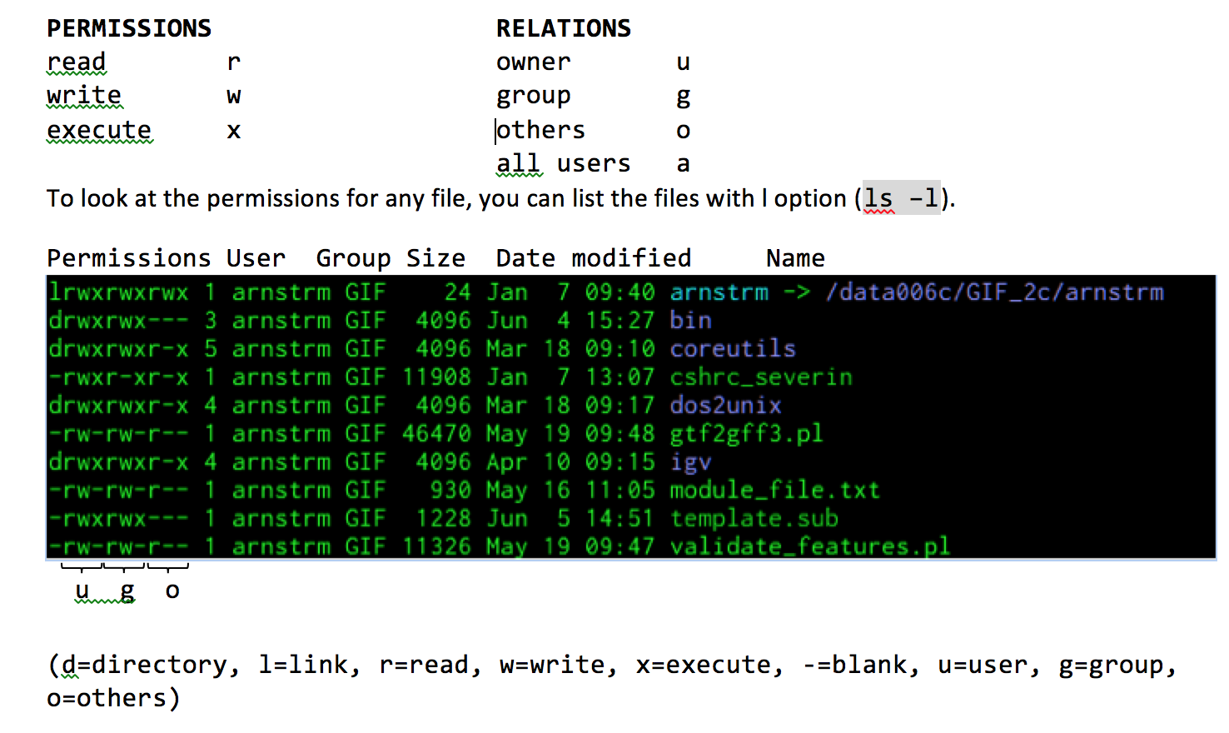
File permissions

Slide 39
File permissions example
chmod 000 YouCannotEnter
ls -l
YouCannotEnter
cd YouCannotEnter
Permission denied!!!!! -- file permission error
chmod a+rx YouCannotEnter/
Now you and everyone can enter this directory
chmod o-rx YouCannotEnter/
Now you and your group can enter this directory
chmod g-rx
Now only you the user can enter this directory

Slide 40
Summary of Part I
Navigation cd, ls, pwd
File creation touch,nano,mkdir,cp,mv,rm,rmdir
Reading more,less,head,tail,cat
Compression zip,gzip,bzip2,tar,compress
Uncompression unzip,gunzip,bunzip2,uncompress
Permissions chmod
Help man
Check your sheet, do you have all of these?
You can now use linux as you do mac or windows OS

Slide 41
Part 2:
Moving data cat,>,>>,<,|
Regular expressions /^.*[0-9]+[a-z]*.*$/
Find and replace grep,sed,tr
Manipulating rows/columns cut,awk
Comparing files wc,sort,uniq,diff,comm
Manipulating files split,join,paste

Slide 42
Moving data
Everyone should be here
/Users/netid/Basic_UNIX/tutorials
Use pwd and check
cat AT_cDNA.fa
Piping | located above enter below delete use shift
cat AT_cDNA.fa | head
seqlen.awk - Generate sequence ID & sequence length from FASTA
cat AT_cDNA.fa | head | ./seqlen.awk
AT1G51370.2 720

Slide 43
Moving Data
cat AT_cDNA.fa | head > new.fasta
more new.fasta
tail -n 30 AT_cDNA.fa | tail -n 30 >> new.fasta
more new.fasta
Create a file named AT_cDNA.len that contains the lengths of each sequence in AT_cDNA.fa

Slide 44
Moving Data
cat AT_cDNA.fa | head > new.fasta
more new.fasta
tail -n 30 AT_cDNA.fa | tail -n 30 >> new.fasta
more new.fasta
Create a file named AT_cDNA.len that contains the lengths of each sequence in AT_cDNA.fa
cat AT_cDNA.fa | ./seqlen.awk > AT_cDNA.len

Slide 45
Find this pattern please!
grep = find this pattern
Example of a simple search
ls | grep ids
ids.txt
ids_a.txt
ids_b.txt
ls | awk '/ids/'
Grab the first 10 headers in AT_cDNA.fa
more AT_cDNA.fa | grep ">" | head > AT_cDNA.head.fa

Slide 46
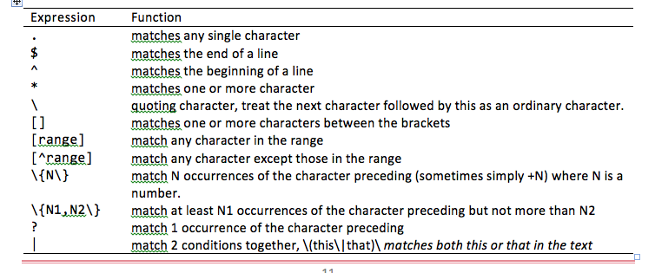
Regular Expressions
Notes:
----- Meeting Notes (6/26/14 10:46) -----
For more complicated patterns we use Regular Expressions

Slide 47
Regular Expressions
you have already seen * = match any character
ls AT*
ls genes*
Let’s grab all the headers that have transposable in their names and start with ATG40 in the gene name.
more AT_cDNA.fa | grep ">AT1G" | grep transposable | grep AT1G40
More succinctly
more AT_cDNA.fa | grep "^>AT1G40.*transposable.*"
Verify they give the same result

Slide 48
Regular Expressions
Now lets find all fasta ids that have chromosome positions between 15 million and 15 million 300 thousand
more AT_cDNA.fa | grep "chr1\:15[0-3][0-9]*" | grep transposable
There is a lot that can be done with regular expression and I encourage you to learn more on your own via the exercises and other online resources

Slide 49
Find and Replace
Replace Symbol with Andrew in AT_cDNA.head.fa
sed 's/Symbols/Andrew/g' AT_cDNA.head.fa
perl -pe 's/Symbols/Andrew/g' AT_cDNA.head.fa
Make all caps
tr 'a-z' 'A-Z' < AT_cDNA.head.fa
cat AT_cDNA.head.fa | tr 'a-z' 'A-Z’

Slide 50
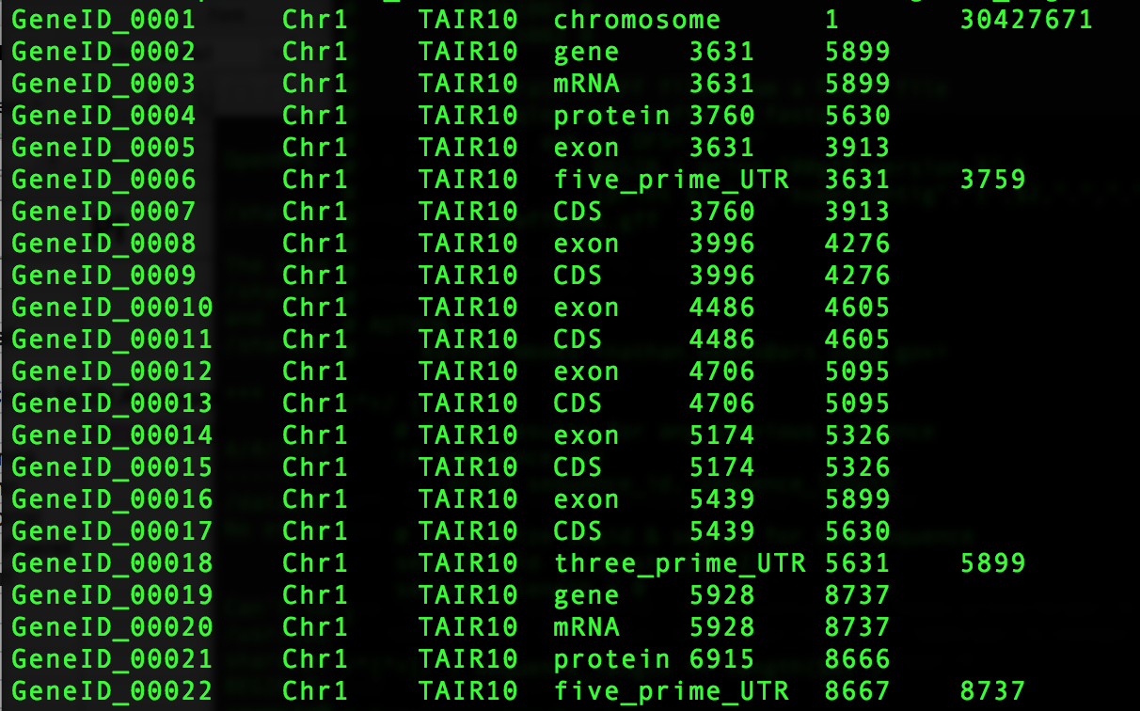
Manipulating rows/columns
More genes_a.gff

Slide 51
Manipulating rows/columns
awk '{print NF}' genes_a.gff | head -n 1
awk '{print NR}' genes_a.gff | tail -n 1
more genes_a.gff
press up to get the last command and modify with arrows
more genes_a.gff | awk '{print $1,$2,$5,$6}' | more
more genes_a.gff | awk '{print $1,$2,$5,$6,$6-$5}' | more
more genes_a.gff | awk '{print $1,$2,$5,$6,$6-$5}' | sort | head
more genes_a.gff | awk '{print $1,$2,$5,$6,$6-$5}' | sort -k 6n | head
more genes_a.gff | awk '{print $1,$2,$5,$6,$6-$5}' | sort -k 6rn | head
more genes_a.gff | awk '{print $1,$2,$4,$5,$6,$6-$5}' | awk '$6>2000'
more genes_a.gff | awk ’OFS=“\t" {print $1,$2,$4,$5,$6,$6-$5}' | sort -k 6rn | head

Slide 52
AWK
BEGIN
 | FS |  |  |  | RS
NR
1 | Field 1 | Field 2 | Field 3 | Field 4 | Field 5
2 | Entry 1A | Entry 2A | Entry 3A | Entry 4A | Entry 5A
3 | Entry 1B | Entry 2B | Entry 3B | Entry 4B | Entry 5B
4 | Entry 1C | Entry 2C | Entry 3C | Entry 4C | Entry 5C
5 | Entry 1D | Entry 2D | Entry 3D | Entry 4D | Entry 5D
6 | Entry 1E | Entry 2E | Entry 3E | Entry 4E | Entry 5E
7 | Entry 1F | Entry 2F | Entry 3F | Entry 4F | Entry 5F
0 | 1 | 2 | 3 | 4 | 5 | NF
(entire line)
 |  |  |  |  | END

Slide 53
How many different Items are in column 4?
more genes_a.gff
more genes_a.gff | awk '{print $4}'
more genes_a.gff | awk '{print $4}' | sort
more genes_a.gff | awk '{print $4}' | sort | uniq
more genes_a.gff | awk '{print $4}' | sort | uniq –c
more genes_a.gff | awk '{print $4}' | sort | uniq -c | sort –rn
You can also use cut to grab a collumn.
cut -f 4 genes_a.gff
cut -f 4- genes_a.gff

Slide 54
Comparing files
more AT_cDNA.fa
more AT_cDNA.fa | grep ">" | more
more AT_cDNA.fa | grep ">" | awk '{print $1, $NF}' | more
more AT_cDNA.fa | grep ">" | awk '{print $1,$NF}' | sed 's/LENGTH=//g’
more AT_cDNA.fa | grep ">" | awk '{print $1,$NF}' | sed 's/LENGTH=//g’
more AT_cDNA.fa | grep ">" | awk '{print $1,$NF}' | sed 's/LENGTH=//g’ | perl -pe ‘s/>//g’
more AT_cDNA.fa | grep ">" | awk '{print $1,$NF}' | sed 's/LENGTH=//g' | perl -pe 's/>//g' > AT_cDNA.len2
cat AT_cDNA.fa | ./seqlen.awk > AT_cDNA.len

Slide 55
Comparing files
diff AT_cDNA.len AT_cDNA.len2
comm AT_cDNA.len AT_cDNA.len2

Slide 56
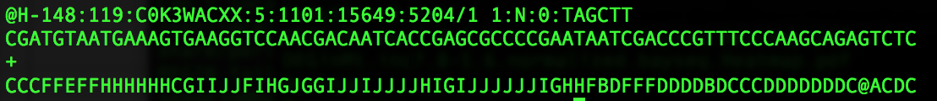
Manipulating files
more R1.fastq | paste - - - - | more
more R1.fastq | paste - - - - | awk '{print $1,$2; print $3}’
more R1.fastq | paste - - - - | awk '{print $1,$2; print $3}’ | sed 's/@/>/g’ > R1.fasta

Slide 57
Manipulating files
wc R1.fastq
split -l 4000 R1.fastq R1_
ls R1_* | wc

Slide 58
Summary Part 2
Moving data cat,>,>>,<,|
Regular expressions /^.*[0-9]+[a-z]*.*$/
Find and replace grep,sed,tr
Manipulating rows/columns cut,awk
Comparing files wc,sort,uniq,diff,comm
Manipulating files split,join,paste

Slide 59
Part 3
Logging into hpc-class (remote machine)
ssh
Transferring and Downloading data
Git,wget,rsync,scp
Preinstalled software
Understanding Queues
Qstat, qtop
Submitting Jobs

Slide 60
High Performance Computing (HPC)
HPC-class (education)
48 compute nodes
16 processors/node (768 total)
64Gb RAM/node (3.0Tb total)
Lightning3 (research)
17 compute nodes
32 processors/node (384 total)
256Gb RAM/node (3.2Tb total)
Compute Nodes
Condo (up coming)
316 compute nodes
8 processors/node (2528 total)
8Gb RAM/node (3.5Tb total)
Head Node
Terminal
SSH
Notes:
Can throw almost anything at it.
Lightning3 is a shared resource that researchers have been buying into it.
Condo will be an order of magnitude more nodes.

Slide 61
Logging in
Microsoft Windows:
PuTTY is an extremely small download of a free, full-featured SSH client.
SSH Secure Shell Client, also a full featured client that is commercial. It is available as part of the Iowa State University site-licensed software.

Slide 62
Logging in
Macintosh
ssh -X username@hpc-class.its.iastate.edu
Note: You will not see your password as you type.

Slide 63
Logging in
ls nothing in your folder
ls -la
pwd /home/netid
who Who else is on this machine
cp -r /home/severin/Basic_UNIX .
cd Basic_UNIX/WORKSHOP_FILES
The remote machine will have a prompt that looks like
[netid@hpc-class WORKSHOP_FILES]$

Slide 64
Transferring and downloading files
Downloading from a website
wget http://goo.gl/CDXx15 =soybean annotation
How do we look at this file?

Slide 65
Transferring and downloading files
Transferring files from our local machine to the remote machine
Open up a new terminal
touch cats.txt
scp cats.txt severin@hpc-class.its.iastate.edu:/home/severin
rsync -avz -e ssh cats.txt netid@hpc-class.its.iastate.edu:/home/netid

Slide 66
Pre-installed software
module use /shared/bioinformatics/modules
module avail
module what-is
fastqc --version
module load fastqc
fastqc --version

Slide 67
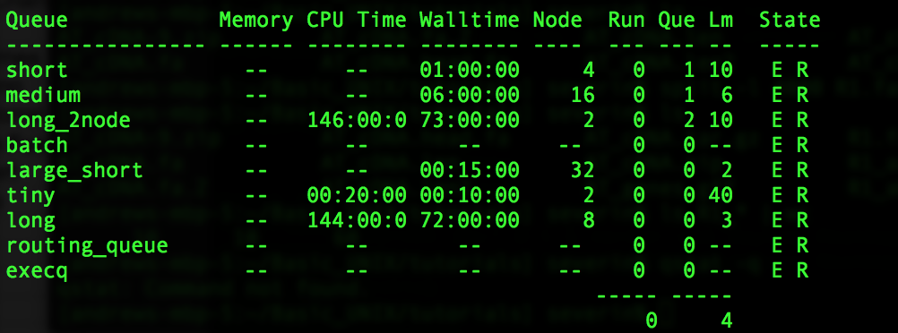
Understanding Torque and Queueing
qstat -q

Slide 68
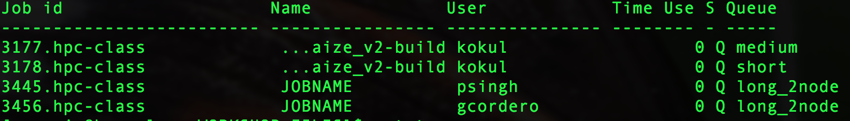
Understanding Torque and Queueing
qstat -a

Slide 69
Submitting a job
#!/bin/bash
#PBS -l vmem=16Gb,pmem=4Gb,mem=16Gb
#PBS -l nodes=1:ppn=4:compute
#PBS -l walltime=48:00:00
#PBS -N FASTQC ← You can change this
#PBS -o ${PBS_JOBNAME}.o${PBS_JOBID} -e ${PBS_JOBNAME}.e${PBS_JOBID}
cd $PBS_O_WORKDIR
fastqc R1.fastq ← Your command here

Slide 70
Submitting a job
/home/netid/Basic_UNIX/WORKSHOP_FILES
more jobfile.sub
qsub jobfile.sub
qstat –a
R1_fastqc.html
R2_fastqc.html
firefox R1_fastqc.html ← to view the results

Slide 71
Summary: Part 3
Logging into hpc-class (remote machine)
ssh
Transferring and Downloading data
git,wget,rsync,scp
Understanding Queues
Qstat, qtop
Submitting Jobs

Slide 72
Where to go from here?
Review the material from the workshop in more detail
Exercises (Basic_UNIX/UNIX_exercises_all.docx)
Unix and Perl primer for Biologists
http://korflab.ucdavis.edu/Unix_and_Perl/
Advanced Unix workshop coming soon!

Slide 73
Post Workshop Survey
Please tell us what you think about this workshop by completing this short survey (10 questions)
http://goo.gl/XJq7Bk

